Slide 1
Combinational Circuits

Slide 2
Digital Logic Circuits
A logic gate is a basic building block of any electronic circuit
Combinational Circuits are categories into two types:
Combinational Circuits in which there are no feedback path from outputs to inputs and there is no memory.
Sequential circuits in which feedback paths exist from output to inputs, and they have memory.

Slide 3
Combinational Circuits
Combinational logic circuits produce a specified output (almost) at the instant when input values are applied.
Combinational Circuits (CC) are circuits made up of different types of logic gates.. The output of the combinational circuit depends on the values at the input at any given time
It does not use any memory.
Example: Adder, Subtractor, Decoder, Multiplexer

Slide 4
Design of combinational Circuit
Starts from the verbal outline of the problem and ends in a logic circuit diagram
The problem started
The input and output variables are assigned letter symbole
The truth table that defines the relationship between inputs and outputs is derived.
The simplified Boolean function for each output are obtained.
Logic diagram is drawn.

Slide 5
Design a combinational circuit with 2 input and produces output as logic zero when one input is one.

Slide 8
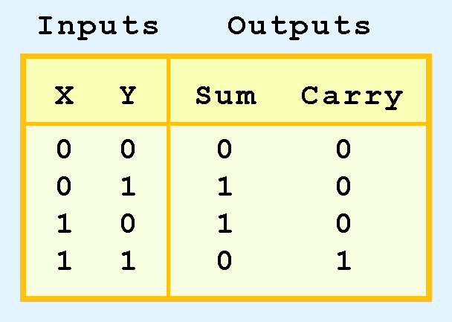
Combinational Circuits
Adder
Combinational logic circuits give us many useful devices.
One of the simplest is the half adder, which finds the sum of two bits.
We can gain some insight as to the construction of a half adder by looking at its truth table, shown at the right.

Slide 9
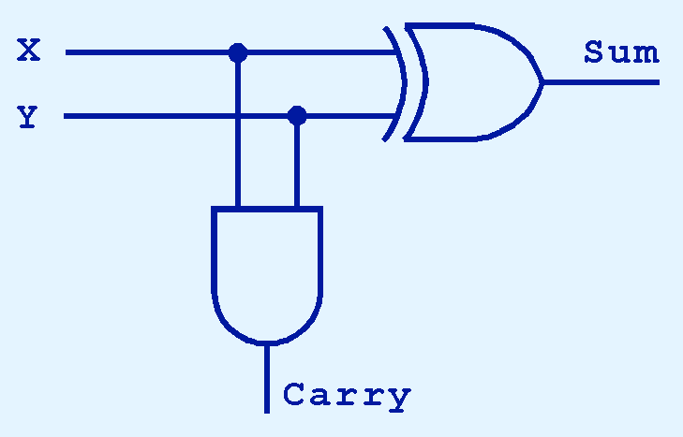
Combinational Circuits
As we see, the sum can be found using the XOR operation and the carry using the AND operation.

Slide 10
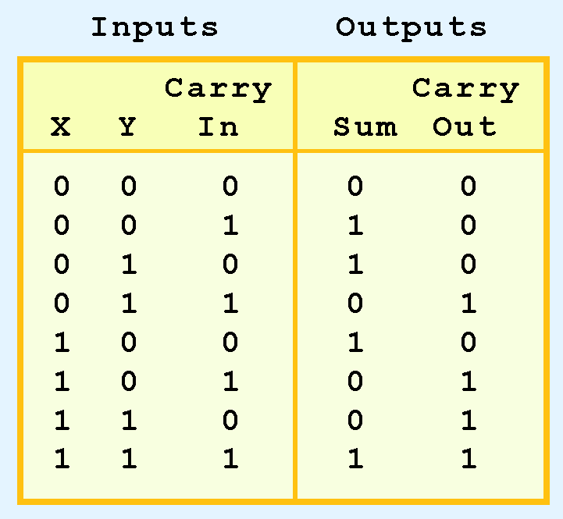
Combinational Circuits
We can change our half adder into to a full adder by including gates for processing the carry bit.
The truth table for a full adder is shown at the right.

Slide 11
Combinational Circuits
How can we change the half adder shown below to make it a full adder?

Slide 12
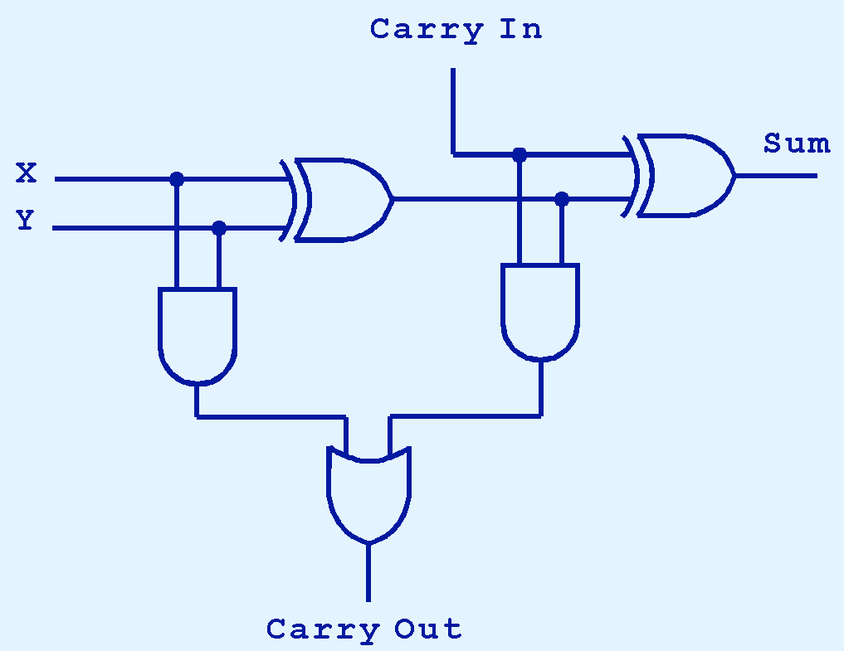
Combinational Circuits
Here’s our completed full adder.

Slide 13

Combinational Circuits
Just as we combined half adders to make a full adder, full adders can connected in series.
The carry bit “ripples” from one adder to the next; hence, this configuration is called a ripple-carry adder.
Today’s systems employ more efficient adders.

Slide 14
sequential circuits, flip-flops

Slide 15
Sequential Circuits
Combinational logic circuits are perfect for situations when we require the immediate application of a Boolean function to a set of inputs.
There are other times, however, when we need a circuit to change its value with consideration to its current state as well as its inputs.
These circuits have to “remember” their current state.

Slide 16

Sequential Circuits
As the name implies, sequential logic circuits require a means by which events can be sequenced.
State changes are controlled by clocks.
A “clock” is a special circuit that sends electrical pulses through a circuit.
Clocks produce electrical waveforms such as the one shown below.

Slide 17
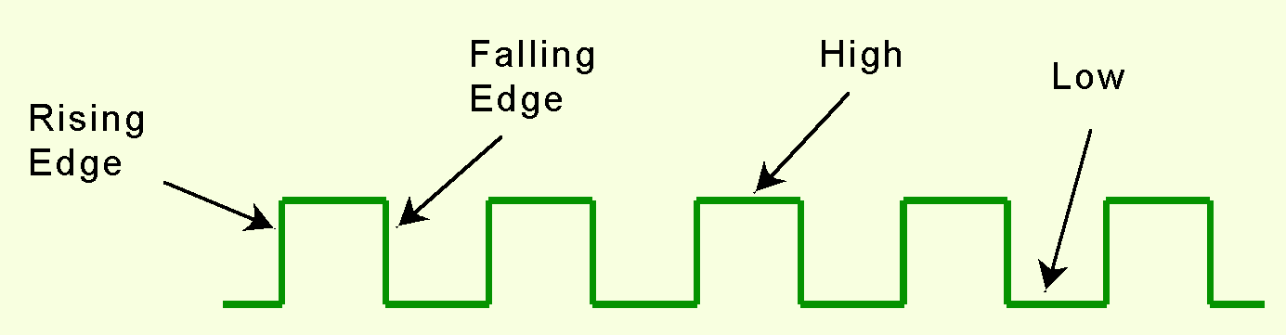
Sequential Circuits
State changes occur in sequential circuits only when the clock ticks.
Circuits can change state on the rising edge, falling edge, or when the clock pulse reaches its highest voltage.

Slide 18
Sequential Circuits
To retain their state values, sequential circuits rely on feedback.
Feedback in digital circuits occurs when an output is looped back to the input.

Slide 19
Flip Flops
The storage element employed in clocked sequential circuits are called flip-flops.
A flip flop is a binary cell capable of storing one bit of information.
2 output 1 is normal value; 2 is complement.
There are difference among various type of flip flops is in number of inputs they posses and in manner in which the inputs affect the binary state.

Slide 20
Sequential Circuits
The behavior of an SR flip-flop is described by a characteristic table.
Q(t) means the value of the output at time t. Q(t+1) is the value of Q after the next clock pulse.

Slide 21
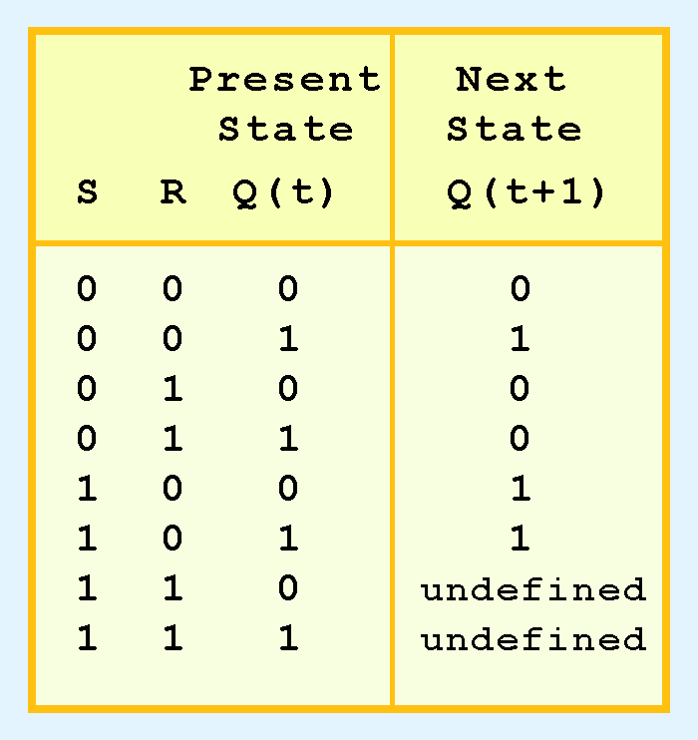
Sequential Circuits
The SR flip-flop actually has three inputs: S, R, and its current output, Q.
Thus, we can construct a truth table for this circuit, as shown at the right.
Notice the two undefined values. When both S and R are 1, the SR flip-flop is unstable.

Slide 22
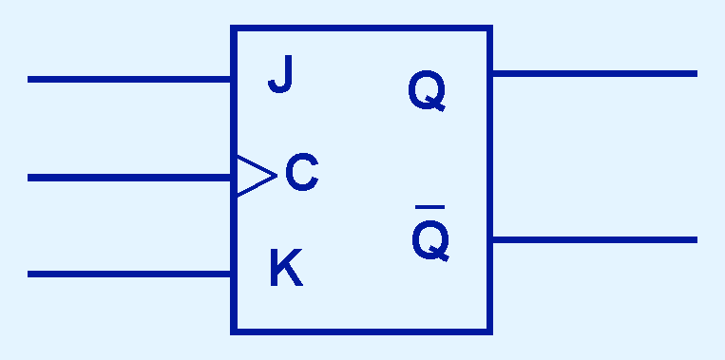
Sequential Circuits
If we can be sure that the inputs to an SR flip-flop will never both be 1, we will never have an unstable circuit. This may not always be the case.
The SR flip-flop can be modified to provide a stable state when both inputs are 1.
• This modified flip-flop is called a JK flip-flop, shown at the right.
- The “JK” is in honor of
Jack Kilby.

Slide 23
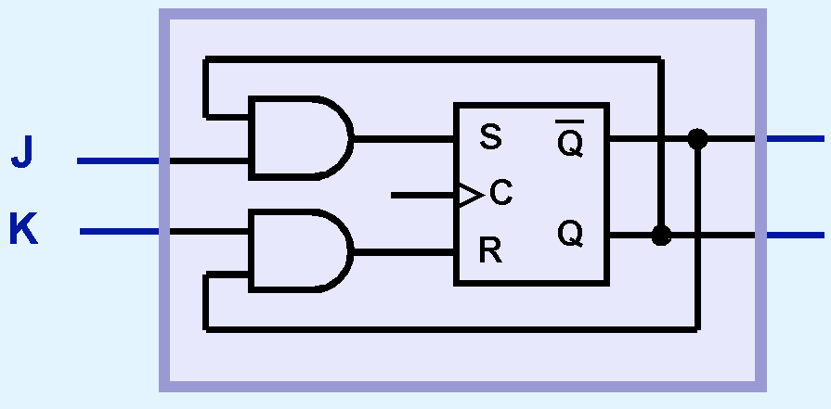
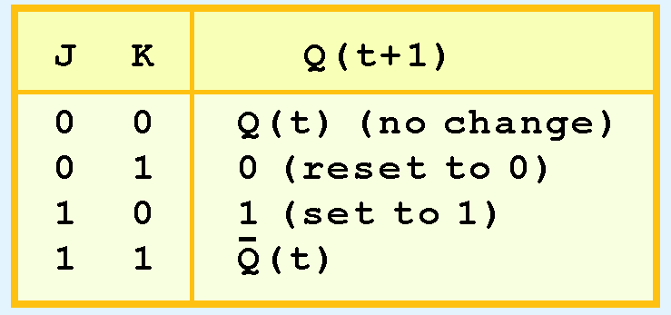
Sequential Circuits
At the right, we see how an SR flip-flop can be modified to create a JK flip-flop.
The characteristic table indicates that the flip-flop is stable for all inputs.

Slide 27
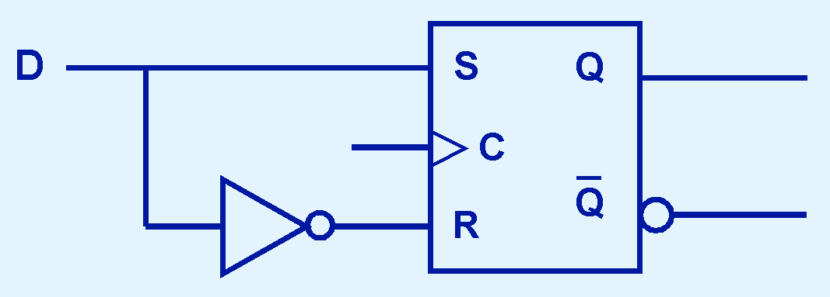
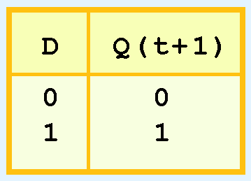
Sequential Circuits
Another modification of the SR flip-flop is the D flip-flop, shown below with its characteristic table.
You will notice that the output of the flip-flop remains the same during subsequent clock pulses. The output changes only when the value of D changes.

Slide 28
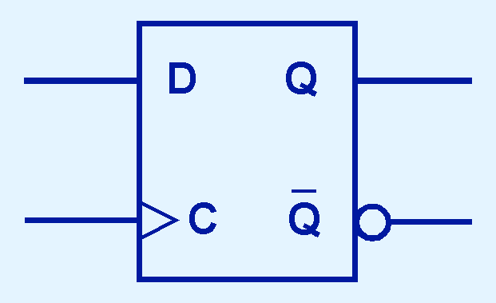
Sequential Circuits
The D flip-flop is the fundamental circuit of computer memory.
D flip-flops are usually illustrated using the block diagram shown below.
The characteristic table for the D flip-flop is shown at the right.

Slide 30
Flip Flop Equations :
The part of the combinational circuit that generates the input to flip flops are described by set of Boolean expression called Flip-flop Input equations.

Slide 31
State Table
The behavior of a sequential circuit is determine from the input, outputs and the state of it flip-flops.
Both the output and the next state are a function of the input an present state .
A sequential circuit is specified by a state table that relates the output and next state as a function of inputs and present state.

Slide 32
State Table for example

Slide 33
State Diagram
The information in a state table can be represented graphically in a state diagram.
State is represented by circle.
The transition between states is indicated by directed lines connecting the circles.

